Slide 1
Bending the Curve
Progress and challenges towards the 2020 targets on HIV Prevention
Casper W. Erichsen, International HIV/AIDS Alliance
25 July 2018

Slide 2
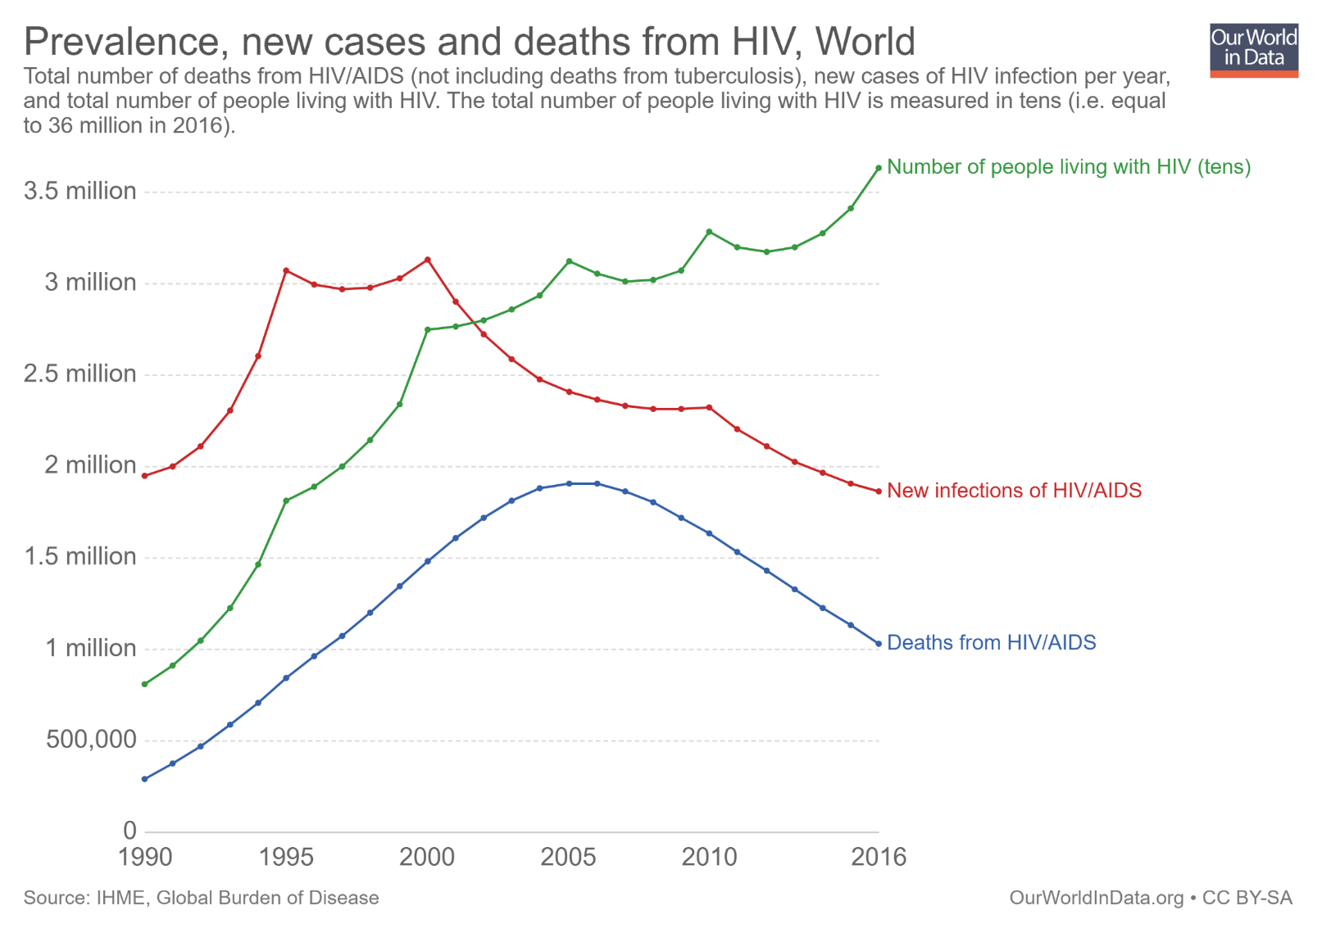
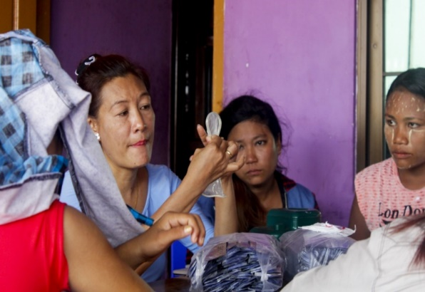
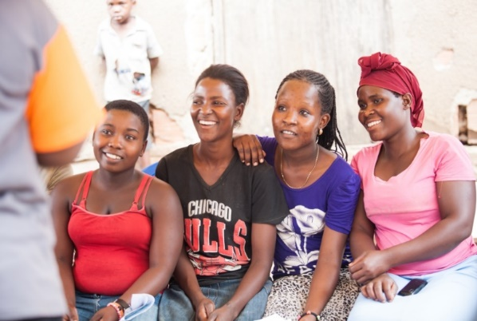
HIV: A story of progress and challenges
Notes:
My brief is to frame this session, which will look at a modernisation of HIV prevention by a balanced curation. I want to start off by doing a quick reflection about the road we have walked together to towards our present prevention predicament.
To date, an estimated that 76 million people were or are currently living with HIV. That is an enormous number of people. In fact, I don’t think that there are many of us in this room who have not been affected, directly or indirectly, by the epidemic.
In my adopted country of Namibia, we had regions where up to 43% of pregnant women tested positive during the early 2000s. In other words, a young girls lifetime risk of contracting HIV was somewhere between certain and guaranteed.
In those days the tools at our disposal to respond to HIV were rudimentary yet pursued with zeal and passion. The frontline of the response was the community, where people were mobilised to disseminate essential information, and commodities like condoms and lubricants, while also pushing social and cultural boundaries in order to shape the way for a public health response.
It was a time of innovation and drive that saw a lasting fusing of public health and human rights thinking, which gave birth to such powerful concepts as PHDP and combination prevention.
And as depicted here, these efforts did bear fruit. The first time the incidence curve was truly curved was back in the mid to late 90s and early 2000s. Of course there was a so-called maturing of the epidemic, but incidence has in fact been in steady decline since about 2001, quite a while before the effects of life saving treatment started to have an impact, as shown here on the red line.
The point I am making is that primary prevention was and remains effective.
The fact that we have we now have U=U in our prevention toolkit, makes this next slide all the more puzzling.

Slide 3
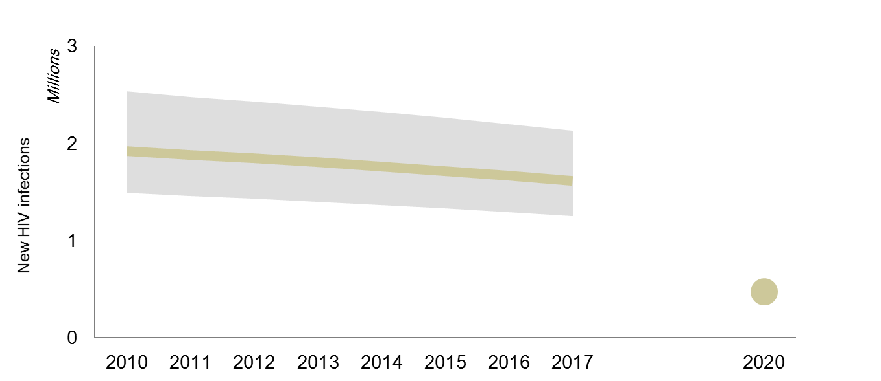
New HIV infections among adults (15+ years), globally, 2010–2017 and 2020 target
2020 Target
Source: UNAIDS Global AIDS Update, 2018.
* The 2020 target is fewer than 500 000 new infections, equivalent to a 75% reduction since 2010
Notes:
The latest UNAIDS data shows that since 2010, new HIV infections among adults have declined by an estimated 16%, from 1.9 million to 1.6 million in 2017, which is far away from reaching a 75% reduction by 2020.
As is being said very often here, there is less than, I think, 600 days until we are supposed to meet a target that, over the previous 2,800 days, we have barely made a dent to. We appear unlikely to achieve that, which is why we are now openly talking about a prevention crisis.
The biggest questions is, how has this happened? How? As repeatedly stated by UNAIDS in their gap reports and even in the famous ‘armamentarium’ report of the Lancet Commission, we have the tools and we know that they work. So why are we here? The big and safe explanation is that there is a global population bulge which has increased the number of people at risk. This is without doubt true.
However, a harder truth to face, is that many primary prevention programmes have suffered from a trio of factors: they have been weak or scattered and of insufficient scale to truly have an impact.

Slide 4
Notes:
Few things illustrate this as clearly as this slide, presented by Henk van Renterghem on Monday during this conference, which shows the tragic collapse of condom programmes in 35 countries across the world.

Slide 5
Key populations are key to ending AIDS
Notes:
To finish of my frameing, I am going to state the obvious: If we want to end new infections we have to make targeted investments to do so.
Again according to UNAIDS, 44% of all new infections occur among key populations and their sexual partners. Even in so-called generalised epidemics, key populations are disproportionally affected.
Why is that? Sex workers, men who have sex with men, drug users and the transgeender community have multiple, ineracting layers of barriers to get through before they can access safe and relevant services.
We also cannot ignore the impact that structural barriers have on adolescent girls and young women, for example, another demographic with extreme risks in regions such as Eastern and South Africa.
To reach our targets, it seems obvious that we must pursue real efforts to remove structural barriers to access, and that by whatever means possible, we provide services to those who are most marginalised and those who have the highest chances of contracting HIV.
If the last 8 years have tought us anything it is that half measures only get you halfway. And in this case even less. When it comes to prevention, we are not on the last mile, we have only just covered the first mile

Slide 6
www.aidsalliance.org
Notes:
If you is interested in knowing more about there we are with the current effort to end new infections, the Alliance has produced a series of shadow scorecards in relation to the global prevention targets that track progress and gaps. These will soon be uploaded on our website. It shows shocking statistics like the rising incidence curve in Ukraine (not what we had in mind when we said bend the curve).

